Slide 1
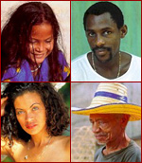
Anthropology literally means the “science of mankind.”
Notes:
But it is only one of the sciences of man. There are many other social sciences such as sociology, psychology, political science, and economics. What distinguishes anthropology from the other social sciences is its holistic approach. Anthropologists try to understand the interaction between a variety of systems and processes that influence human behavior.

Slide 2
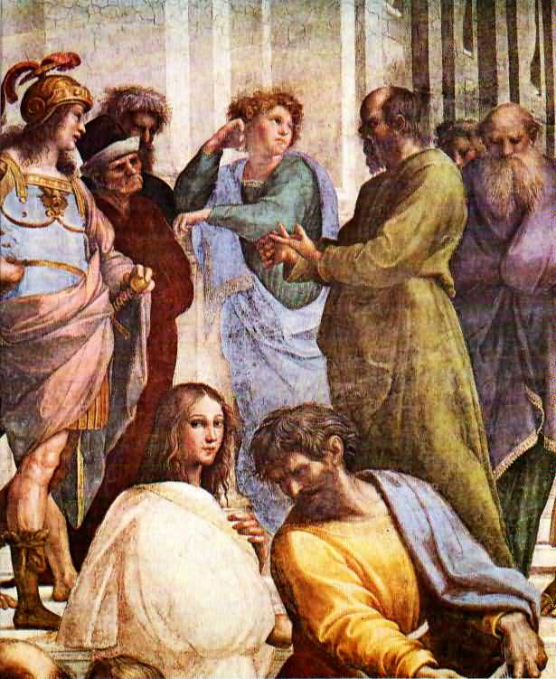
The social or behavioral sciences grew out of inquiries about the nature of humanity which date back to Greek and Roman times.
Socrates
Notes:
Of course, great thinkers in non-western traditions were conducting equally valid and interesting inquiries. But, the social sciences, as we study them today, were really products of the Age of Enlightenment.

Slide 3
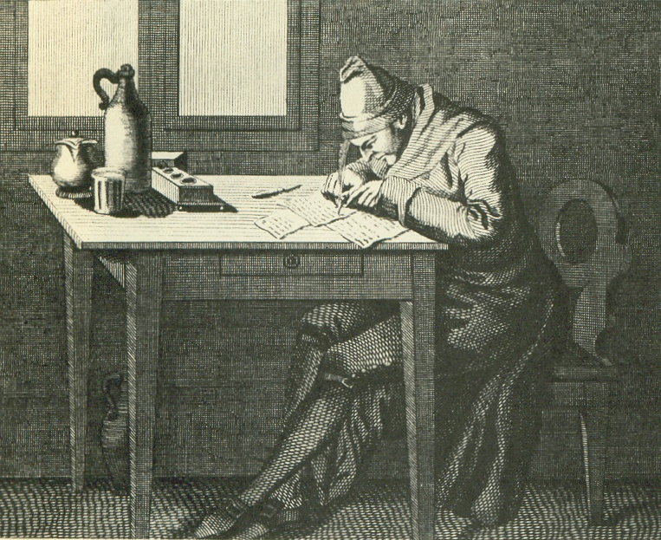
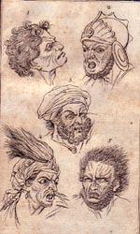
The idea that human society was an appropriate scientific area of study began to develop in seventeenth century Europe.
Physiognomist John Lavater
Notes:
Not all of the ideas scholars came up with during this era were good or progressive. Physiognomists like John Lavater believed that personality could be determined by facial characteristics. Not only were his ideas a dead-end scientifically, but they were used to justify racism.

Slide 4
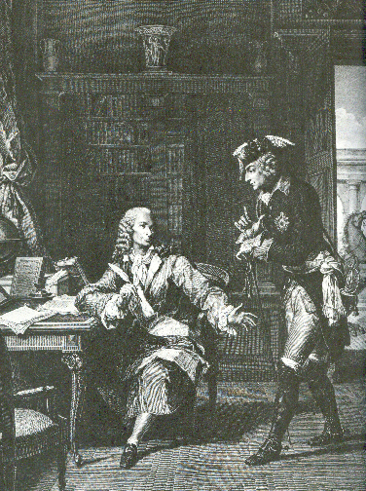
For the most part, however, the Age of Enlightenment meant that intellectuals were free, within limits, to talk and think about what was good and bad in their societies and in others.
Voltaire and King Fredrick II of Prussia
Notes:
This new freedom was coupled with a growing awareness of the huge variety of human experience. This was the result of dramatic improvements in communications and transportation.

Slide 5
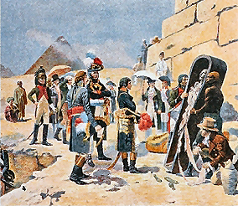
Anthropology began to develop a distinct character as a discipline in its own right in the early nineteenth century.
Napoleon in Egypt
Notes:
In 1800, a group of French medical men and naturalists founded a group called “The Society of the Observers of Man.” They were particularly interested promoting the study of human behavior among travelers, explorers, and colonial administrators.

Slide 6
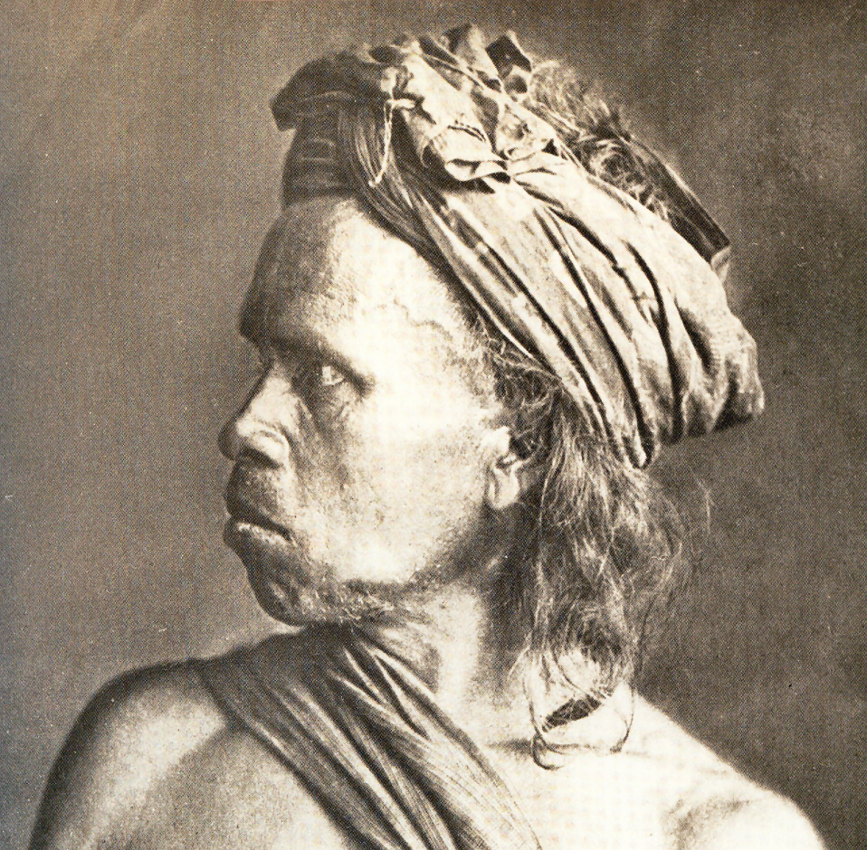
Because colonialists often kept detailed diaries and wrote long letters, they became the earliest ethnographers.
Batak Tribesman –c. 1880
Notes:
Ethnography is best defined as detailed reporting on the manners and customs of geographically dispersed human groups, In 1820, Sir Thomas Raffles, the British Governor of Java, wrote: “The Bataks are not a bad people, and I still think so, not withstanding they eat one another, and relish the flesh of a man better than that of a pig. You must merely consider that I am giving you an account of a novel state of society. The Bataks are not savages, for they write and read, and think full as much, and more than those who are brought up at our Lancastrian and National Schools.” His comments exemplify the conflict in his times between the ideal of the noble savage and preconceptions about “civilized” behavior.

Slide 7
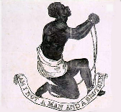
In 1838, a society with both intellectual interests and a social agenda similar to the “Society of the Observers of Man” was formed in London.
Notes:
It was called the “Society for the Protection of Aborigines”. This group more concerned about political and social issues than scientific ones because the abolition of slavery was becoming a topic of great concern in England. These developments were noted on the other side of the channel but, because of conservatism associated with the recent restoration of the French monarchy, it was not possible for the French to form such a blatantly liberal political association. Instead, in 1839 a group of French scientists established the “Ethnological Society of Paris”.

Slide 8
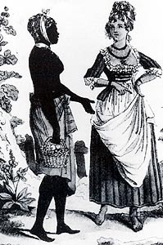
Their first order of business was an attempt to compare the distinctive characteristics of black and white people.
Women in West Indies
Notes:
They wanted to know if there was a scientific basis for the contemporary belief that white people were intellectually superior to black people because this idea was used as a justification for slavery.

Slide 9
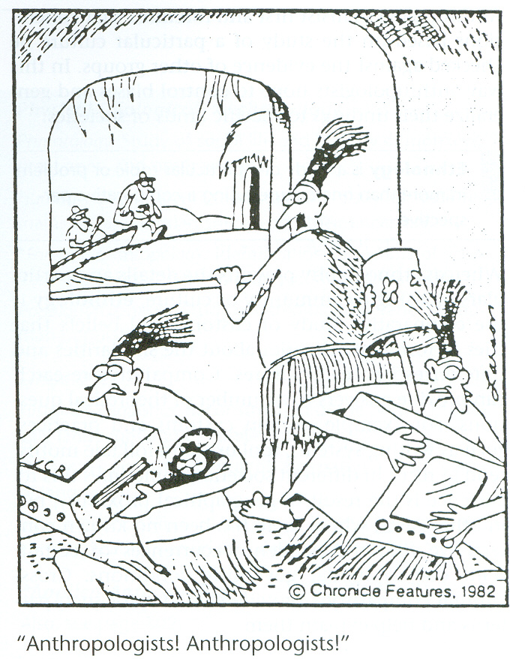
The Four Fields of Anthropology
Physical Anthropology
Archaeology
Anthropological Linguistics
Cultural Anthropology
Notes:
Today, anthropology is divided into four major fields.

Slide 10
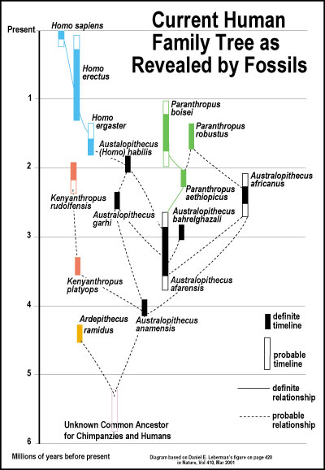
Physical Anthropology
Paleoanthropology
Biological Anthropology
Notes:
Paleoanthropologists are concerned with the study of human evolution through fossil remains. Primatologists study non-human primates in their natural environments with the aim of gaining insight into human evolution. Biological anthropologists study both human evolution and contemporary physical variations among the world's people. Our understanding of human evolution is being considerably enhanced through the study of population genetics, the study of inherited physical traits. Some biological anthropologists also study the interrelationship between human populations and their environments. Epidemiologists contribute to the anthropological dialogue by investigating the transmission of disease among human populations. Other kinds of medical anthropologists study the relationship between biology and sociocultural factors related to health and disease. They may study the culture of medical institutions and health care providers or specialize in nutrition. Nutritional anthropologists believe understanding the relationship between the human diet and culture can provide us with insights into health and behavior.

Slide 11
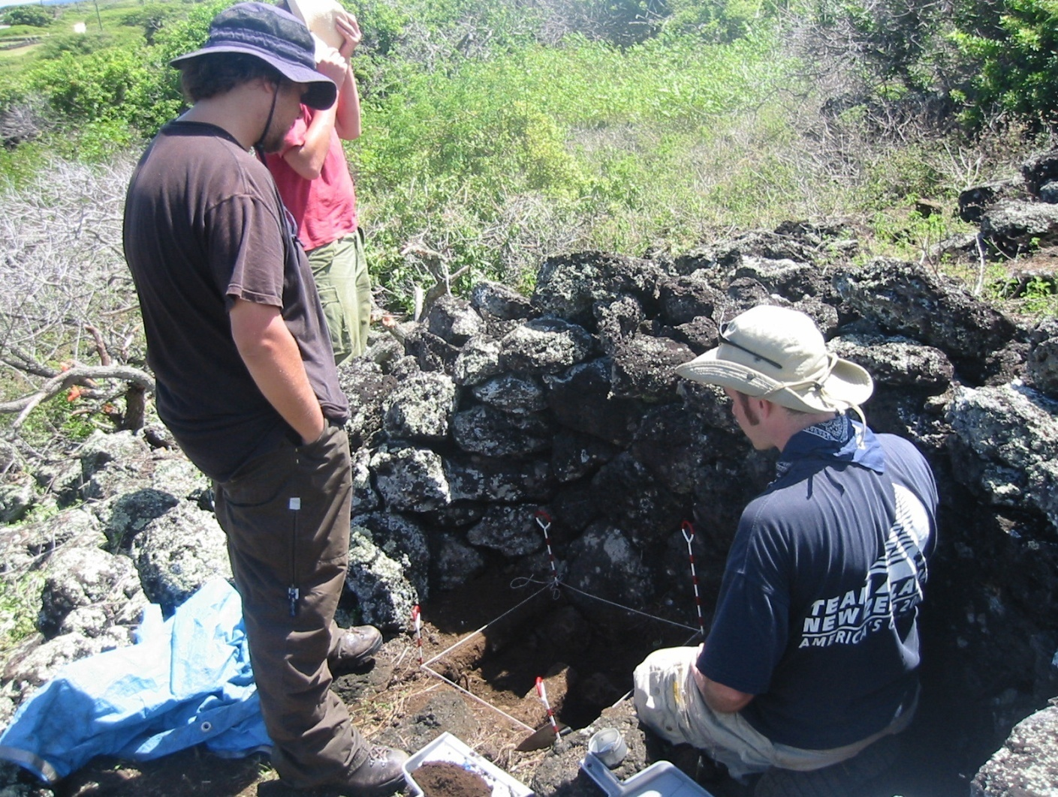
Archaeology
Archaeologists working in Hawaii uncover a stone lined hearth (left to right, Jonathan Carpenter, Calum Wilkenson (back), and Mark McCoy).
Notes:
Archaeologists study people of the past by excavating and analyzing material remains. They look not only at human remains but the artifacts people leave behind. They can derive a surprising amount of information from such things as the location of the postholes in ancient dwellings or even the pollen found in levels of soil associated with other artifacts. Cultural resource management is the area of archaeology that deals with ensuring the preservation of archeological sites. Sometimes an archeological site is impacted by proposed construction. An archeologist may be called upon to determine the significance of the site and help devise a plan to protect it. If the damage is unavoidable, the archeologist may excavate to get as much information from the area as possible before it is destroyed. Cultural resource managers are also often called upon to monitor construction to make sure that nothing of cultural significance is inadvertently damaged. Due to the proliferation of protection laws at both the state and federal level, cultural resource management has become a growth industry. Today, about half of all archeologists work in this area.

Slide 12

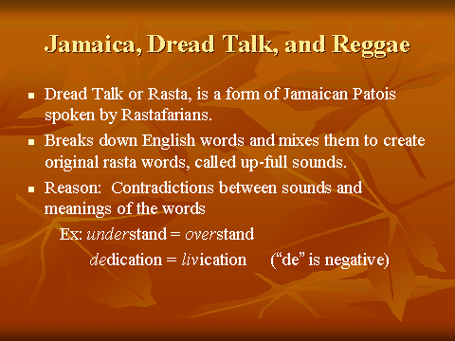
Anthropological Linguistics
Notes:
Sociolinguists can learn a lot about human behavior by studying how people use language. They look at how languages change over time, how languages separate and combine, and investigate the relationship between language and culture. If you want to do a little sociolinguistic investigation of your own, listen to your fellow students when they get together on campus. Some will practice code-switching, that is, they will combine two languages such as Spanish and English in one conversation. A code-switcher must be skilled in the grammar and vocabulary of two languages. It says a lot about the cultural environment in which they grew up.

Slide 13
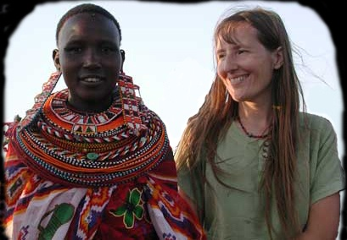
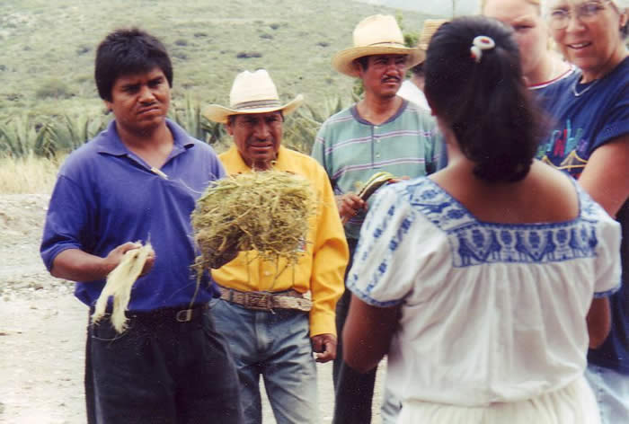
Cultural Anthropology
Notes:
A sociolinguist is one kind of cultural anthropologist. Cultural anthropologists look at the intersections of a variety of cultural systems such as law, religion, kinship, political structures, etc. in order to understand other people. Some write ethnographies describing cultures in which they live. Others are ethnologists who compare cultures on the basis of information they and others have collected. They may work in traditional cultures around the world or in the world's growing urban areas.

Slide 14
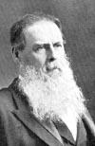
Edward Tylor 1832-1917
The concept of “culture” became central to the development of theory among social anthropologists and ethnographers.
Notes:
In 1871, Edward Tylor introduced the classic definition of “culture” in the first paragraph of his influential work, Primitive Culture. He said:

Slide 15
Culture . . . is that complex whole which includes knowledge, belief, art, morals, law, custom, and any other capabilities and habits acquired by man as a member of society.
Notes:
More than any other idea, it is the concept of culture that identifies and drives the work of cultural anthropologists.

Slide 16
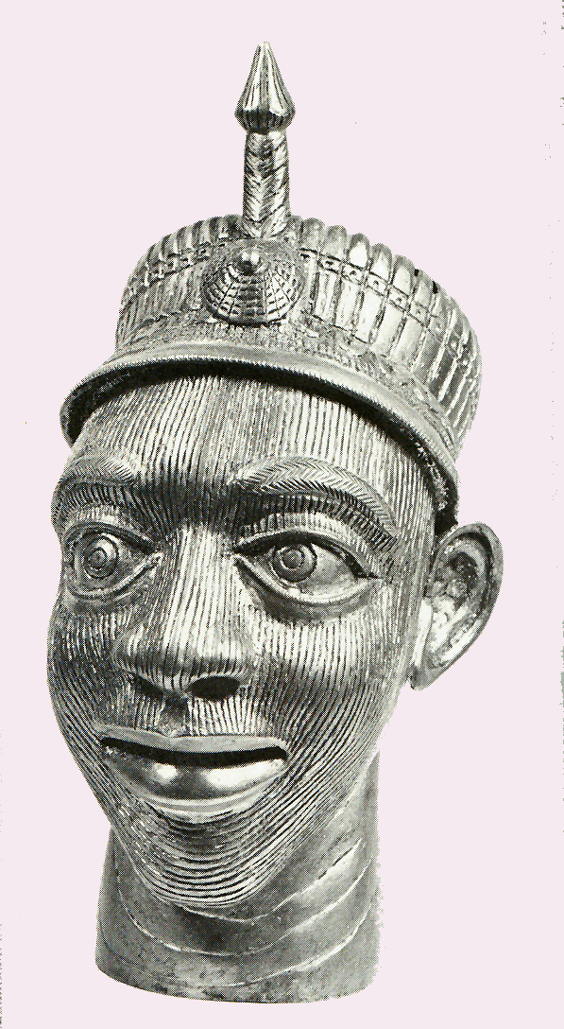
As time went on anthropologists became more curious about the way certain cultural materials and traits passed from group to group.
Copy of an Ife (Nigerian) bronze head wearing a western military helmet by an artist from Cameroun
Notes:
The people they studied were changing. Diffusion and adaptation became central areas of concern. Anthropologists began to realize that behavioral traits are best understood when they are viewed within the cultural context or contexts in which they function. This is called cultural relativism. Cultural relativism is a reaction to ethnocentrism. Ethnocentrism is the practice of interpreting the customs of other human groups from the viewpoint of one’s own. It is not possible to totally avoid ethnocentrism since our cultural programming is complex and subtle. But, what we can do is to try to avoid making judgmental comparisons of the cultural practices of others without trying to understand their original cultural milieu. When a cultural trait is viewed from the perspective of a cultural insider it is called the emic view. An outsider sees the same phenomenon from the etic perspective.

